Slide 1
Electric Charge
Definition: The quantity of electricity that flows in a given time or is held in a component such as a capacitor
Symbol: q
Unit: Coulomb (C)
Notes: Charges may be positive or negative
Like charges (e.g., + and +) repel each
other, unlike charges (+ and -) attract each
other
EE 42 and 100, Fall 2005
Week 1

Slide 2
Electric Current
Definition: rate of positive charge flow
Symbol: i
Units: Coulombs per second ≡ Amperes (A)
i = dq/dt
where q = charge (in Coulombs), t = time (in seconds)
Note: Current has polarity (flow direction).
EE 42 and 100, Fall 2005
Week 1

Slide 3
Electric Potential (Voltage)
Definition: energy per unit charge expended in moving a
charge from one place to another
Symbol: v
Units: Joules/Coulomb ≡ Volts (V)
v = dw/dq
where w = energy (in Joules), q = charge (in Coulombs)
Note: Potential is always referenced to some point.
a
Subscript convention:
v_{ab} means the potential at a minus the potential at b.
b
v_{ab} ≡ v_{a} - v_{b}
EE 42 and 100, Fall 2005
Week 1

Slide 4
Electric Power
Definition: amount of energy transferred per unit
time
Symbol: p
Units: Joules per second ≡ Watts (W)
p = dw/dt = (dw/dq)(dq/dt) = vi
Concept:
  As a positive charge q moves through a drop in voltage of amount v, it loses energy
  energy change = qv
  rate is proportional to # charges/sec
EE 42 and 100, Fall 2005
Week 1

Slide 5
The Ideal Basic Circuit Element
i
Polarity reference for voltage can be
indicated by plus and minus signs
Reference direction for the current
is indicated by an arrow
Examples: resistor, capacitor,
inductor, diode, …
+
v
_
Attributes:
Two terminals (points of connection)
Cannot be subdivided into other elements
Mathematically described by its current-voltage
relationship
EE 42 and 100, Fall 2005
Week 1

Slide 6
A Note about Reference Directions
A problem like “Find the current” or “Find the voltage” is always accompanied by a definition of the direction:
i
- v +
In this case, if the current turns out to be 1 mA flowing to the left, we would say i = -1 mA. (See prefixes in Hambley, p. 18.)
In order to perform circuit analysis to determine the voltages and currents in an electric circuit, you need to specify reference directions. There is no need to guess the reference direction so that the answers come out positive, however.
EE 42 and 100, Fall 2005
Week 1

Slide 7
Sign Convention for Power
Passive sign convention
p = vi
p = -vi
i
i
i
i
_
v
+
_
v
+
+
v
_
+
v
_
If p > 0, power is being delivered to the gray box.
If p < 0, power is being extracted from the box.
EE 42 and 100, Fall 2005
Week 1

Slide 8
Circuit Elements
5 ideal basic circuit elements:
  voltage source
  current source
  resistor
  inductor
  capacitor
Many practical systems can be modeled with just sources and resistors
The basic analytical techniques for solving circuits with inductors and capacitors are the same as those for resistive circuits
active elements, capable of
generating electric energy
passive elements, incapable of
generating electric energy
EE 42 and 100, Fall 2005
Week 1

Slide 9
Electrical Sources
An electrical source is a device that is capable of converting non-electric energy to electric energy and vice versa.
  Examples:
  battery: chemical electric
  dynamo (generator/motor): mechanical electric
Electrical sources can either deliver or absorb power
EE 42 and 100, Fall 2005
Week 1

Slide 10
Ideal Independent and Dependent Voltage Sources
Circuit element that maintains a prescribed voltage across its terminals, regardless of the current flowing in those terminals.
  Voltage is known, but current is determined by the circuit to which the source is connected.
The voltage can be either independent of dependent on a voltage or current elsewhere in the circuit, and can be constant or time-varying.
Circuit symbols:
v_{s}
+
v_{s}=μ v_{x}
+
v_{s}=ρ i_{x}
+
_
_
_
independent
voltage-controlled
current-controlled
EE 42 and 100, Fall 2005
Week 1

Slide 11
Ideal Independent and Dependent Current Sources
Circuit element that maintains a prescribed current through its terminals, regardless of the voltage across those terminals.
  Current is known, but voltage is determined by the circuit to which the source is connected.
The current can be either independent or dependent on a voltage or current elsewhere in the circuit, and can be constant or time-varying.
Circuit symbols:
i_{s}
i_{s}=α v_{x}
i_{s}=β i_{x}
independent
voltage-controlled
current-controlled
EE 42 and 100, Fall 2005
Week 1

Slide 12
Electrical Resistance
Resistance: Electric field is proportional to current density, within a resistive material. Thus, voltage is proportional to current. The circuit element used to model this behavior is the resistor.
  Circuit symbol:
  Unit for R: Volts per Ampere ≡ ohms (Ω)
The current flowing in the resistor is proportional to the voltage across the resistor:
v = i R
where v = voltage (V), i = current (A), and R = resistance (Ω)
R
(Ohm’s Law)
EE 42 and 100, Fall 2005
Week 1

Slide 13
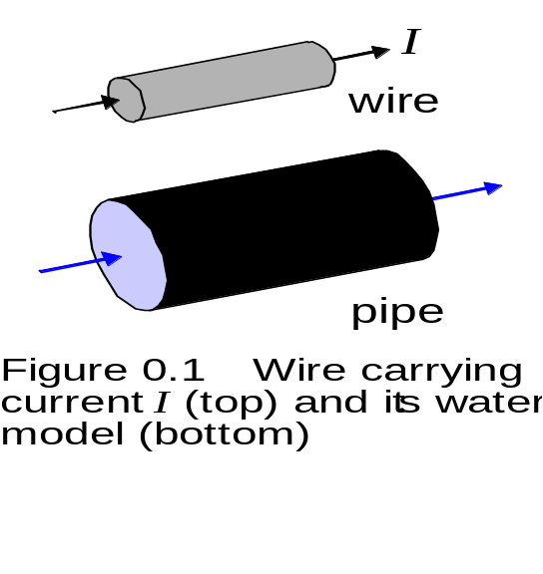
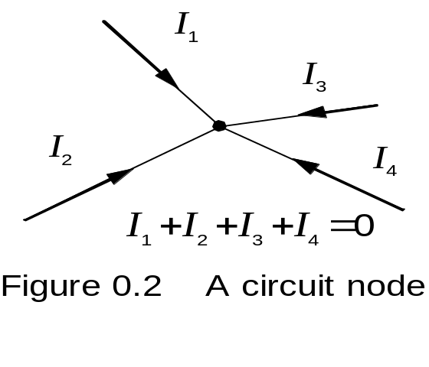
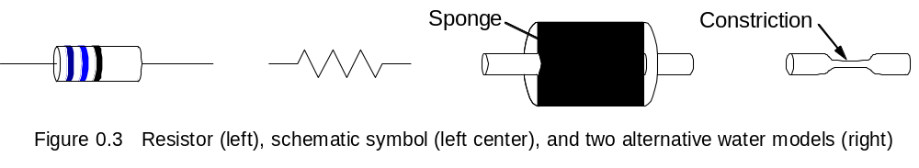
Water Models for Currents and Resistors
EE 42 and 100, Fall 2005
Week 1

Slide 14
Electrical Conductance
Conductance is the reciprocal of resistance.
  Symbol: G
  Units: siemens (S) or mhos ( )
  Example:
    Consider an 8 Ω resistor. What is its conductance?
Ω
EE 42 and 100, Fall 2005
Week 1

Slide 15
Short Circuit and Open Circuit
Wire (“short circuit”):
R = 0 → no voltage difference exists
  (all points on the wire are at the same potential)
Current can flow, as determined by the circuit
Air (“open circuit”):
R = ∞ → no current flows
Voltage difference can exist, as determined by the circuit
EE 42 and 100, Fall 2005
Week 1

Slide 16
Circuit Nodes and Loops
A node is a point where two or more circuit elements are connected.
A loop is formed by tracing a closed path in a circuit through selected basic circuit elements without passing through any intermediate node more than once
EE 42 and 100, Fall 2005
Week 1

Slide 17
Kirchhoff’s Laws
Kirchhoff’s Current Law (KCL):
  The algebraic sum of all the currents entering any node in a circuit equals zero. (An expression of the conservation of charge.)
Kirchhoff’s Voltage Law (KVL):
  The algebraic sum of all the voltages around any loop in a circuit equals zero. (As a result of conservation of energy.)
EE 42 and 100, Fall 2005
Week 1

Slide 18
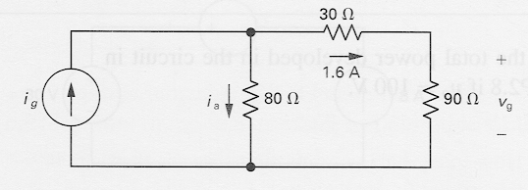
Example: Power Absorbed by a Resistor
p = vi = ( iR )i = i²R
p = vi = v ( v/R ) = v²/R
Note that p > 0 always, for a resistor.
  Example:
  Calculate the voltage v_{g} and current i_{a}.
  Determine the power dissipated in the 80Ω resistor.
EE 42 and 100, Fall 2005
Week 1

Slide 19
Construction of a Circuit Model
The electrical behavior of each physical component is of primary interest.
We need to account for undesired as well as desired electrical effects.
Simplifying assumptions should be made wherever reasonable.
EE 42 and 100, Fall 2005
Week 1

Slide 20
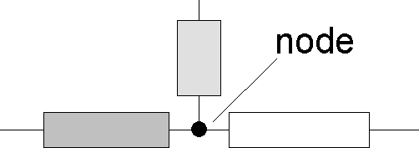
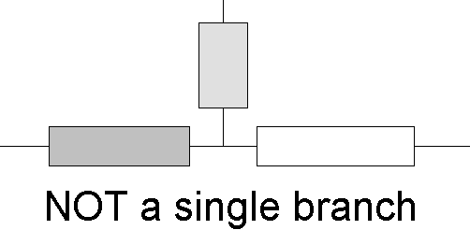
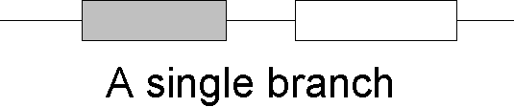
Terminology: Nodes and Branches
Node: A point where two or more circuit elements are connected
Branch: A path that connects two nodes
EE 42 and 100, Fall 2005
Week 1

Slide 21
Notation: Node and Branch Voltages
Use one node as the reference (the “common” or “ground” node) – label it with a symbol
The voltage drop from node x to the reference node is called the node voltage v_{x}.
The voltage across a circuit element is defined as the difference between the node voltages at its terminals
  Example:
– v₁ +
a
R₁
b
+
v_{a}
_
+
v_{b}
_
+
v_{s}
R₂
_
c
← REFERENCE NODE
EE 42 and 100, Fall 2005
Week 1

Slide 22
Using Kirchhoff’s Current Law (KCL)
Consider a node connecting several branches:
i₂
i₃
i₁
i₄
Use reference directions to determine whether currents are “entering” or “leaving” the node – with no concern about actual current directions
EE 42 and 100, Fall 2005
Week 1

Slide 23
Alternative Formulations of Kirchhoff’s Current Law
(Charge stored in node is zero.)
Formulation 1:
Sum of currents entering node
= sum of currents leaving node
Formulation 2:
Algebraic sum of currents entering node = 0
  Currents leaving are included with a minus sign.
Formulation 3:
Algebraic sum of currents leaving node = 0
  Currents entering are included with a minus sign.
EE 42 and 100, Fall 2005
Week 1

Slide 24
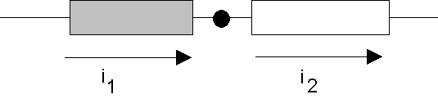
A Major Implication of KCL
KCL tells us that all of the elements in a single branch carry the same current.
We say these elements are connected in series.
Current entering node = Current leaving node
i₁ = i₂
EE 42 and 100, Fall 2005
Week 1

Slide 25
KCL Example
Currents entering the node:
Currents leaving the node:
-10 mA
i
5 mA
15 mA
3 formulations of KCL:
  1.
  2.
  3.
EE 42 and 100, Fall 2005
Week 1

Slide 26
Generalization of KCL
The sum of currents entering/leaving a closed surface is zero. Circuit branches can be inside this surface, i.e. the surface can enclose more than one node!
i₂
i₃
This could be a big chunk of a circuit, e.g., a “black box”
i₄
i₁
EE 42 and 100, Fall 2005
Week 1

Slide 27
Using Kirchhoff’s Voltage Law (KVL)
Consider a branch which forms part of a loop:
+
v₁
_
–
v₂
+
voltage
“drop”
voltage
“rise”
(negative drop)
loop
loop
Use reference polarities to determine whether a voltage is dropped – with no concern about actual voltage polarities
EE 42 and 100, Fall 2005
Week 1

Slide 28
Formulations of Kirchhoff’s Voltage Law
(Conservation of energy)
Formulation 1:
Sum of voltage drops around loop
= sum of voltage rises around loop
Formulation 2:
Algebraic sum of voltage drops around loop = 0
  Voltage rises are included with a minus sign.
Formulation 3:
Algebraic sum of voltage rises around loop = 0
  Voltage drops are included with a minus sign.
(Handy trick: Look at the first sign you encounter on each element when tracing the loop.)
EE 42 and 100, Fall 2005
Week 1

Slide 29
A Major Implication of KVL
KVL tells us that any set of elements that are connected at both ends carry the same voltage.
We say these elements are connected in parallel.
+
v_{a}
_
+
v_{b}
_
Applying KVL in the clockwise direction,
starting at the top:
v_{b} – v_{a} = 0 ➔ v_{b} = v_{a}
EE 42 and 100, Fall 2005
Week 1

Slide 30
Resistors in Series
Consider a circuit with multiple resistors connected in series.
Find their “equivalent resistance”.
KCL tells us that the same current (I) flows through every resistor
KVL tells us
I
R₁
R₂
V_{SS}
+
−
R₃
R₄
Equivalent resistance of resistors in series is the sum
of the individual resistances
EE 42 and 100, Fall 2005
Week 1

Slide 31
Voltage Divider
I = V_{SS} / (R₁ + R₂ + R₃ + R₄)
I
+
–
R₁
V₁
R₂
V_{SS}
+
+
–
−
R₃
V₃
R₄
EE 42 and 100, Fall 2005
Week 1

Slide 32
When can the Voltage Divider Formula be Used?
I
I
R₁
R₁
+
–
+
–
R₂
V₂
R₂
V₂
V_{SS}
+
V_{SS}
+
−
R₃
−
R₃
R₄
R₄
R₅
R
R
V
2
⋅
V
V
2
⋅
V
2
=
SS
2
≠
SS
R
+
R
+
R
+
R
R
+
R
+
R
+
R
1
2
3
4
1
2
3
4
Correct, if nothing else
is connected to nodes
because R₅ removes condition
of resistors in series
EE 42 and 100, Fall 2005
Week 1

Slide 33
Resistors in Parallel
Consider a circuit with two resistors connected in parallel.
Find their “equivalent resistance”.
x
KVL tells us that the
same voltage is dropped
across each resistor
  V_{x} = I₁ R₁ = I₂ R₂
KCL tells us
I₁
I₂
I_{SS}
R₁
R₂
EE 42 and 100, Fall 2005
Week 1

Slide 34
General Formula for Parallel Resistors
What single resistance R_{eq} is equivalent to three resistors in parallel?
I
I
+
+
V
R₁
R₂
R₃
eq
≡
V
R_{eq}
−
−
Equivalent conductance of resistors in parallel is the sum
EE 42 and 100, Fall 2005
Week 1

Slide 35
Current Divider
x
I₁
I₂
I_{SS}
R₁
R₂
V_{x} = I₁ R₁ = I_{SS} R_{eq}
EE 42 and 100, Fall 2005
Week 1

Slide 36
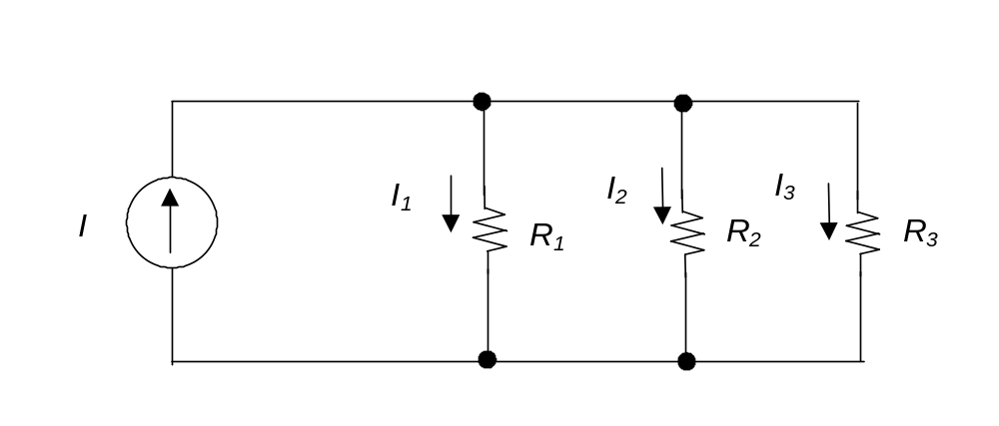
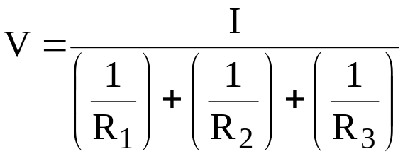
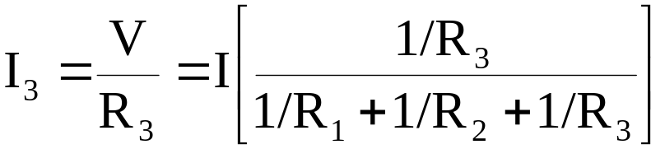
Generalized Current Divider Formula
Consider a current divider circuit with >2 resistors in parallel:
+
V
−
EE 42 and 100, Fall 2005
Week 1

